Slide 1
Up Next - Messaging APIs
Richard Harrington

Slide 2
Agenda
API Introductions
Authentication/Authorization
SMS API
In App Messaging, v2

Slide 3

Messaging APIs
In App Messaging
Cross-carrier
Mobile identity
AT&T offers multiple messaging solutions to fit developer needs
SMS and MMS
AT&T specific
Short code based
SMS and MMS
Shortcode based messaging
Send text or picture messages to AT&T numbers
Receive messages
Track message delivery via polling or push notification
Does not require user consent
In App Messaging
Send to mobile number, e-mail or shortcode from within app
Sends SMS or MMS with single command
Send message to single recipient or group
Message is sent from user’s phone number
Receive message response in App
Requires user consent
Message Notifications
How do I decide which of these messaging APIs to use for my app?

Slide 4
Using the APIs

Slide 5

Authorization
Why Authorization?
Proves that the app is authorized to make the call.
In some cases, proves that user has consented to use of their data
Authorization uses OAuth 2.0
Some APIs require user consent and others don’t. It depends on whether the API uses user-sensitive data.
Notes:
Thanks for a great intro Michael. In this segment we are going run through a few Speech labs but first we must get authorized. In order for you to use the APIs your application must be authorized. APIs that do not pass sensitive personal information implement “no consent” authorization. APIs that do pass sensitive personal information also require user consent.
OAuth version 13.

Slide 6
Examples of APIs and their Consent Requirements
With Consent
In App Messaging
Without Consent
SMS and MMS
Speech
Payment Consent
Notes:
Today we’ll be touching on Speech and In-App Messaging. Speech does not pass sensitive personal information so does not require user connsent. In-App Messaging does so it requires user consent.

Slide 7

Authorization Without Consent
Client Application
API Gateway
Client ID and client secret
Step 1:
Obtain an access token
Access token
Client Application
API Gateway
Access token
Step 2:
Make an API request
API response
Notes:
Richard will cover user consent in the In-App Messaging labs. No-consent authorization is quite simple. We pass our app key and our app secret to the AT&T Oauth API and receive an access token. We use this token in subsequent API calls.

Slide 8
Authorization With Consent
Client Application
Client ID and scope
Consent Server
Step 1:
Obtain consent
Authorization code
Client Application
Client ID, client secret, and code
API Gateway
Step 2:
Obtain an access token
Access token
Step 3:
Make an API request
Client Application
Access token
API Gateway
API response

Slide 9



Which Authorization Model?

Slide 10
Auth Code vs. Client Credentials
Auth Code
Access Token for each Subscriber
Requires Consent
Subscriber can revoke access
Client Credentials
Access Token per Application
No Consent

Slide 11
SMS

Slide 12
Messaging Lab Exercise 1: Authorization
Using OAuth for the SMS API

Slide 13
Getting a Client Credentials Access Token
POST /oauth/token HTTP/1.1
Host: api.att.com
Content-Type: application/x-www-form-urlencoded
Accept: application/json
User-Agent: Test
Content-Length: 129
client_id=ABCDEF0123456789ABCDEF0123456789&
client_secret=ABCDEF0123456789&
grant_type=client_credentials&
scope=SMS,MMS,SPEECH,STTC,TTS
Notes:
As you can see from the JSON response we have received the access_token. Tokens currently have no expiry date but this may change in the future. You can access our Oauth document on the developer portal.
We are now going to try Lab 2 – Obtaining an Access Token. Please open this up and we’ll get started.

Slide 14
Example Response
Response:
{
"access_token":"4a0e9c2b14a0548addb29eb77e06a8b",
"token_type":"bearer",
"expires_in":157679999,
"refresh_token":"f40caf9ef81261882752186087f60071"
}
Token to use in API requests
Note: The expires_in value is in seconds. Before the token expires, use the refresh_token to obtain a new access token.
Notes:
As you can see from the JSON response we have received the access_token. Tokens currently have no expiry date but this may change in the future. You can access our Oauth document on the developer portal.
We are now going to try Lab 2 – Obtaining an Access Token. Please open this up and we’ll get started.

Slide 15
Common Authorization Issues
Here are common issues that occur when using the AT&T Authorization API.
Scope
Scope misspelled
Scope hasn’t been activated through the Developer Program website
Redirect URI must be url-encoded
OAuth token expired (currently doesn’t expire)
Currently, you cannot bypass the end-user consent page

Slide 16
Messaging Lab Exercise 2: SMS API

Slide 17
Sending an SMS
POST /oauth/sms/v3/messaging/outbox HTTP/1.1
Host: api.att.com
Accept: application/json
Content-Type: application/json
Authorization: Bearer <token>
Content-Length: 129
{
"outboundSMSRequest": {
"address": "tel:+15555555555",
"message": "Hello World"
}
}

Slide 18
SMS API Response
Response:
{
"outboundSMSResponse": {
"messageId": "SMSa98944bbc8535f4d",
"resourceReference": {
"resourceURL": "https://api.att.com/sms/v3/messaging/outbox/SMSa98944bbd8535f4d"
}
}
}
Use this URL to check message delivery status

Slide 19
SMS API Response for Checking Status
Response:
{
"DeliveryInfoList": {
"DeliveryInfo": [
{
"Id": "msg0",
"Address": "tel:+15555555",
"DeliveryStatus": "DeliveredToTerminal"
}
],
"ResourceUrl": "https://api.att.com/sms/v3/messaging/outbox/SMSa98944bbc8535f4d"
}
}

Slide 20
Common SMS/MMS API Issues
Here are common issues that occur when using the AT&T Messaging APIs.
SMS
Get SMS does not work for the online shortcode that is automatically generated. Need to create an offline shortcode.
Receive SMS requires a listener service that needs to be set up properly
MMS
When using the SMIL format, how MMS messages appear on the device will depend on how SMIL is implemented on the device.
Only 10 messages can be sent at one time.

Slide 21
In App Messaging, v2

Slide 22
Messaging Lab Exercise 3: Obtaining an Access Token with User Consent

Slide 23
Authorization with User Consent
Required when accessing user data or acting on their behalf
Information about the user’s device
Sending messages from user’s phone number
Payment
“Three-legged” OAuth is used, where customer consent is obtained through an AT&T website.
You specify a website that will be redirected to when the user grants consent.
For the OAuth call, the grant_type parameter is authorization_code.

Slide 24
Authorization With Consent
Client Application
Client ID and scope
Consent Server
Step 1:
Obtain consent
Authorization code
Client Application
Client ID, client secret, and code
API Gateway
Step 2:
Obtain an access token
Access token
Step 3:
Make an API request
Client Application
Access token
API Gateway
API response

Slide 25
Step 1: OAuth Redirect
Redirect to:
https://api.att.com/oauth/authorize?
client_id=<appkey>&scope=<scope>

Slide 26
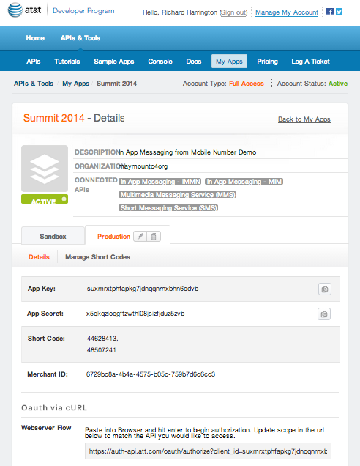
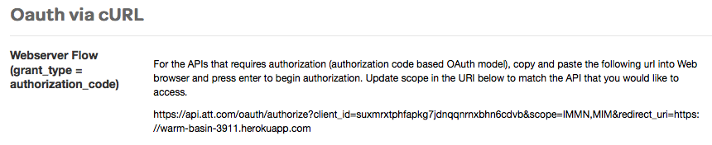
Getting the Authorization Code Redirect URL

Slide 27
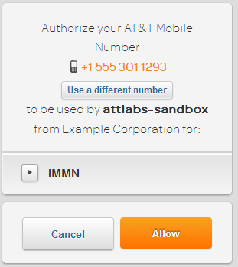
Obtaining Consent - On Network
If on an AT&T device, a page like this will appear:
When the user clicks Allow, the browser will be redirected to website that you specified when registering the app.
The redirect URL will have a parameter called code that will have the authorization code.

Slide 28
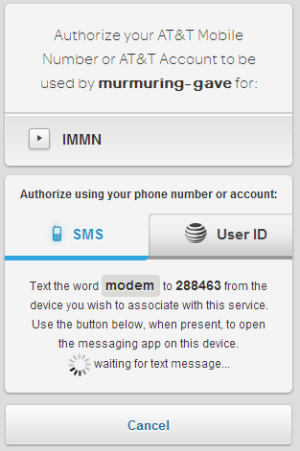
Obtaining Consent - Off Network
If not on an AT&T device, a page like this will appear.
Option 1: Use a phone to sign in
Using your AT&T device, text the specified word to the shortcode listed.
Once received, the redirection will occur.

Slide 29
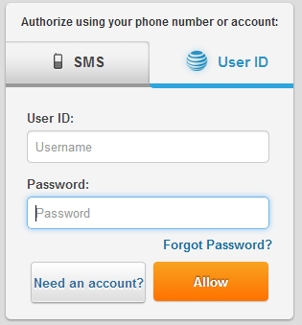
Obtaining Consent - User ID
Click the User ID tab to sign in with an AT&T username and password.
Option 2:
The user can also give consent through an AT&T username/password

Slide 30
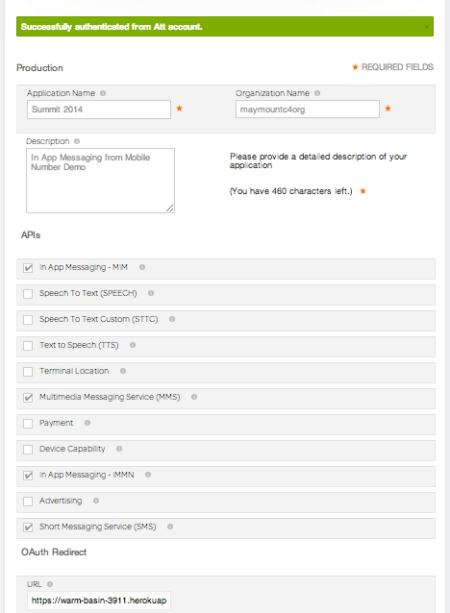
Setting the OAuth Redirect

Slide 31
The Redirect Back
URL that browser is redirected to:
http://redirect.example.com/ code=243gZiyL9bTiUrRDRTMhwb
Code to use in OAuth token requests

Slide 32
Step 2: Exchange Authorization Code for Access Token
All APIs require Access Tokens
Auth Code access tokens represent consent for a Subscriber
Store the auth code access tokens for each Subscriber

Slide 33
Getting an Authorization Code Access Token
POST /oauth/token HTTP/1.1
Host: api.att.com
Content-Type: application/x-www-form-urlencoded
Accept: application/json
Content-Length: 129
client_id=ABCDEF0123456789ABCDEF0123456789&
client_secret=ABCDEF0123456789&
code=ABCDEF0123456789ABCDEF&
grant_type=authorization_code
Auth Code from redirect
Notes:
As you can see from the JSON response we have received the access_token. Tokens currently have no expiry date but this may change in the future. You can access our Oauth document on the developer portal.
We are now going to try Lab 2 – Obtaining an Access Token. Please open this up and we’ll get started.

Slide 34
Example Response
Response:
{
"access_token":"8a0e9c2b14a0548addb29eb77e06a8b",
"token_type":"bearer",
"expires_in":157679999,
"refresh_token":"f40caf9ef812618827521860874a6f60071"
}
Token to use in API requests

Slide 35
Messaging Lab Exercise 4: In App Messaging from Mobile Number

Slide 36
In App Messaging from Mobile Number
Send to mobile number, e-mail or shortcode from within app
Mobile numbers can be AT&T or other carriers
Sends SMS or MMS with single command
Cannot send MMS to shortcode
Send message to single recipient or group
Message is sent from user’s phone number
Receive message response in App
Requires user consent

Slide 37
Sending an In App Message from a Mobile Number
POST /myMessages/v2/messages HTTP/1.1
Host: api.att.com
Accept: application/json
Content-Type: application/json
Authorization: Bearer <token>
Content-Length: 129
{ "messageRequest":
{
"addresses" : ["tel:2064952785"],
"text":"Hello World”
}
}

Slide 38
In App Messaging from Mobile Number API Response
Successful response:
{
"Id": "Cbe0o3YpujSUpR66FGT"
}

Slide 39
In App Messaging Notifications

Slide 40
In App Messaging Notifications
Your
Application
AT&T API Gateway
Subscribe
Message
Message

Slide 41
Notifications
Three Steps:
Use “Get Connection Details” method to get credentials & URL
Start WebSocket connection
Use STOMP protocol to Subscribe
Sample code in:
https://github.com/maymount/iam_stomp

Slide 42
The Quick Messaging Tour…

Slide 43
Summary
SMS and MMS
Sending text and binaries to/from shortcodes
AT&T Subscribers only
No Consent required
Use for larger volume, on behalf-of an organization
In App Messaging
Send messages on behalf-of AT&T Subscribers
Receive messages sent to AT&T Subscribers
Works with non-AT&T Subscribers
Use for “social messaging”, sending to groups of people

Slide 44
Thank You! Richard Harrington (206)495-2785 rh8730@att.com

Slide 45
Just In Case…

Slide 46
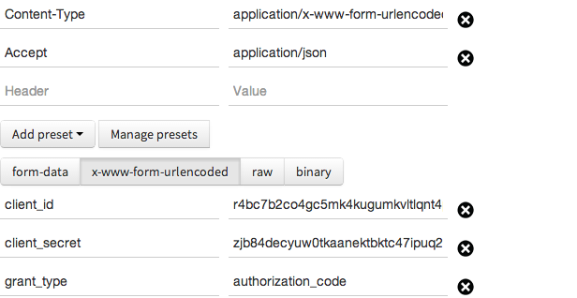
Auth Code Request

Slide 47
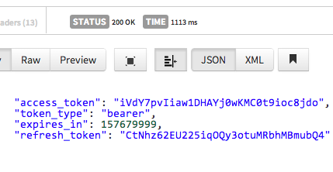
Auth Code Response

Slide 48
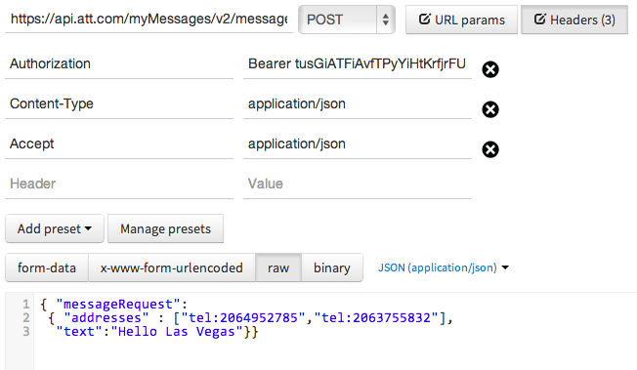
Send Message Request

Slide 49
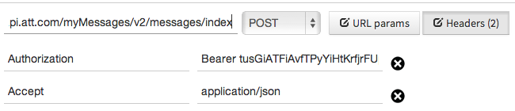
Create Message Index Request

Slide 50
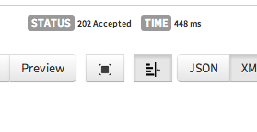
Create Message Index Response

Slide 51
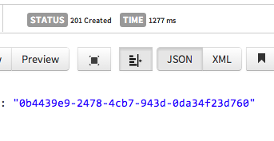
Send Message Response

Slide 52
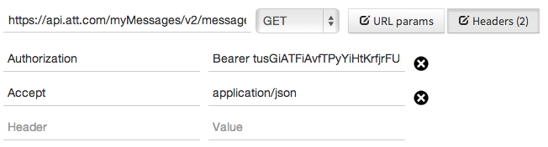
Get Message List

Slide 53
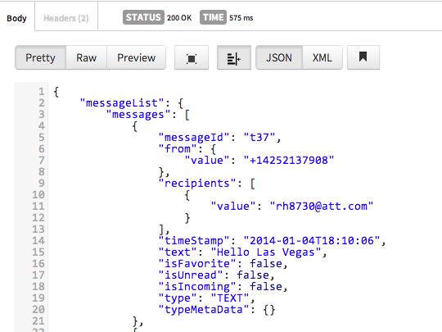
Get Message List Response

Slide 54
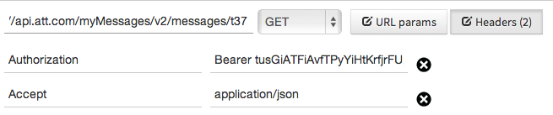
Get Message Contents Request

Slide 55
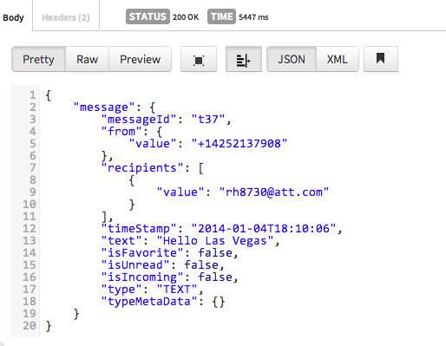
Get Message Contents Response

Slide 56
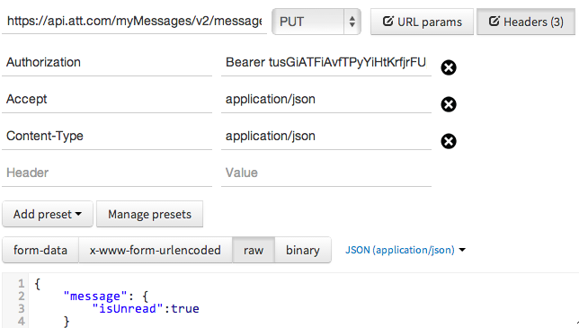
Update Message Request

Slide 57
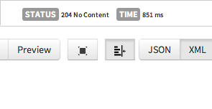
Update Message Response

Slide 58
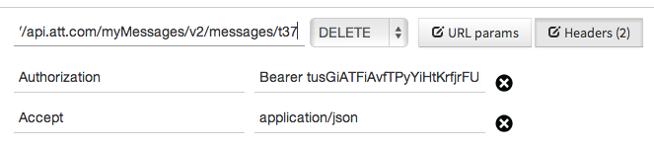
Delete Message Request

Slide 59
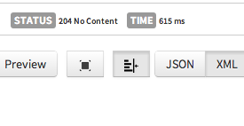
Delete Message Response

